Slide 1
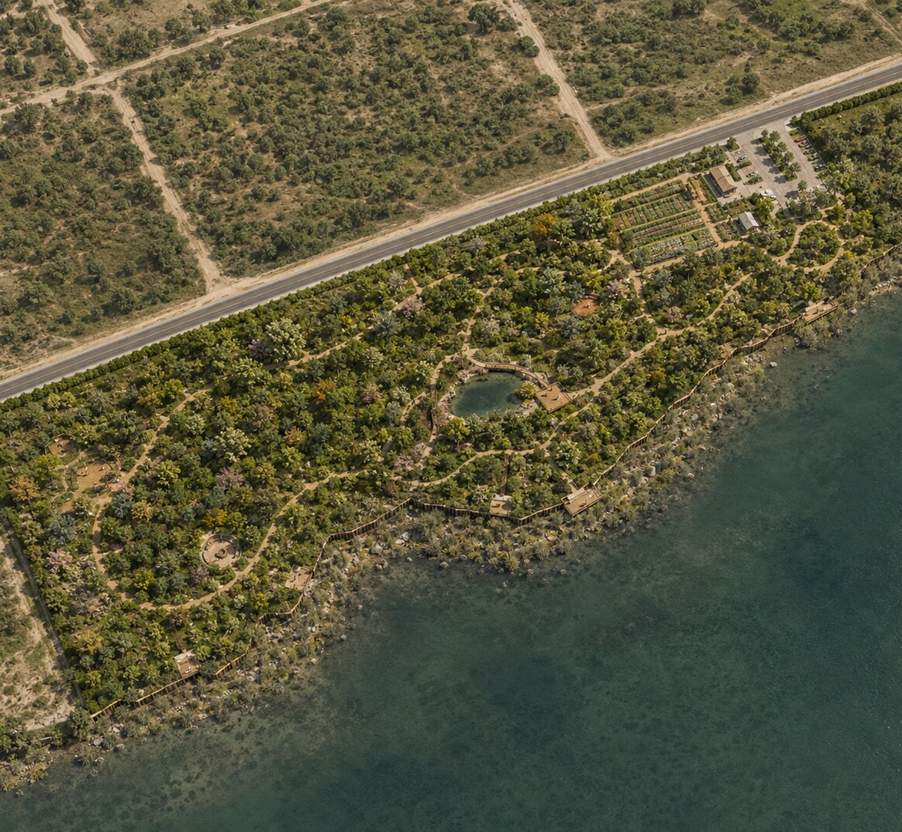
ARCHITECTURAL CONCEPT PRESENTATION
Urban Forest
at Education City
20-acre ecological master plan
and 3D visualization
A climate-responsive destination combining native afforestation, education, food production and low-impact recreation.
URBAN FOREST • EDUCATION CITY
01
Notes:
[Sources]
- User-provided Google Slides: Urban Forest Presentation (Architect)
- User-provided PDFs: Urban Forest Dimensions; Urban Forest Topography Survey
- User-provided activity reference images
- AI-generated conceptual visualization based on the supplied brief and references
[/Sources]

Slide 2
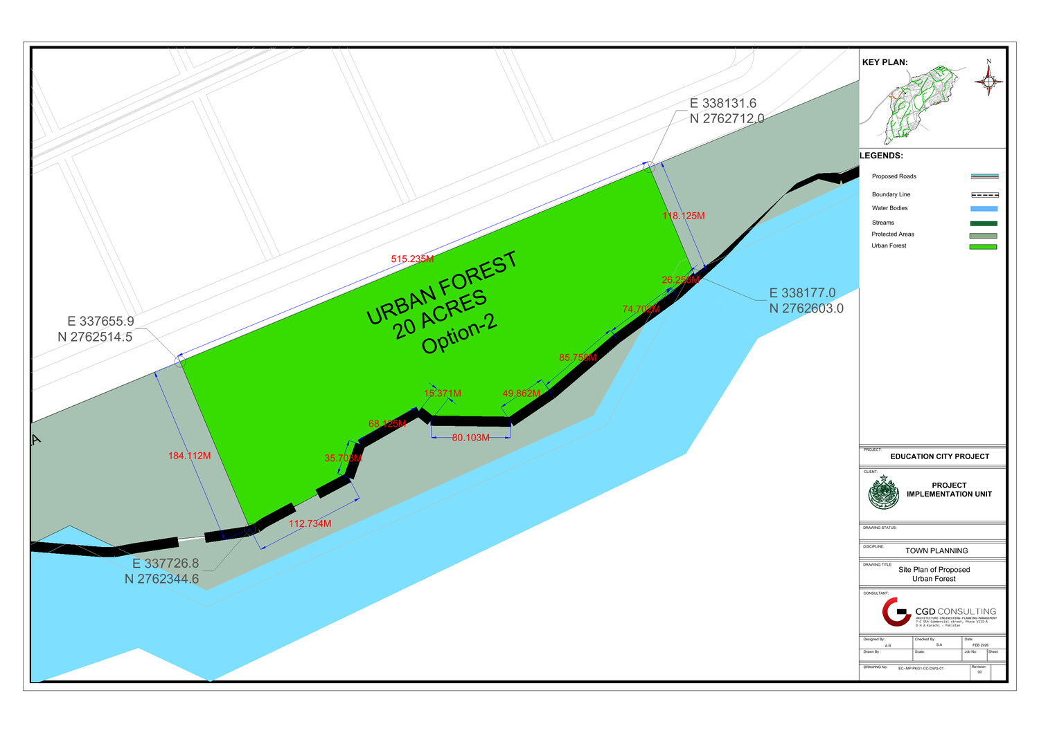
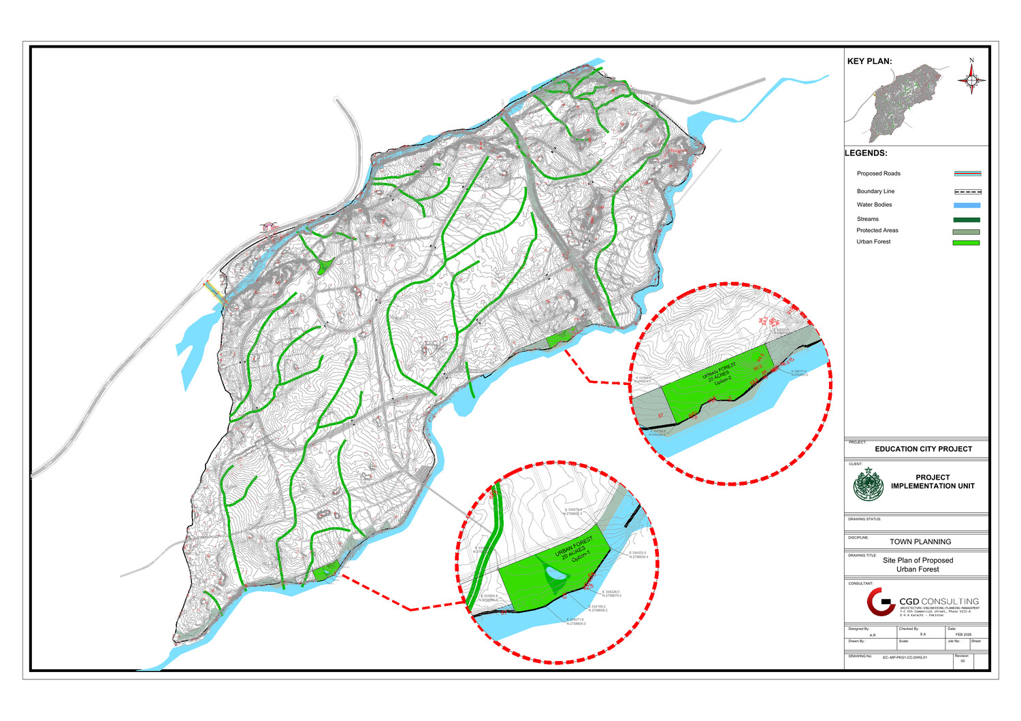
SITE FRAMEWORK
A 20-acre destination shaped by road, slope and water
SITE BOUNDARY
TOPOGRAPHY
20 ACRES
~18 ACRES NATIVE PLANTATION
ROAD ACCESS + PROTECTED WATER EDGE
URBAN FOREST • EDUCATION CITY
02
Notes:
[Sources]
- User-provided Google Slides: Urban Forest Presentation (Architect)
- User-provided PDFs: Urban Forest Dimensions; Urban Forest Topography Survey
- User-provided activity reference images
- AI-generated conceptual visualization based on the supplied brief and references
[/Sources]

Slide 3
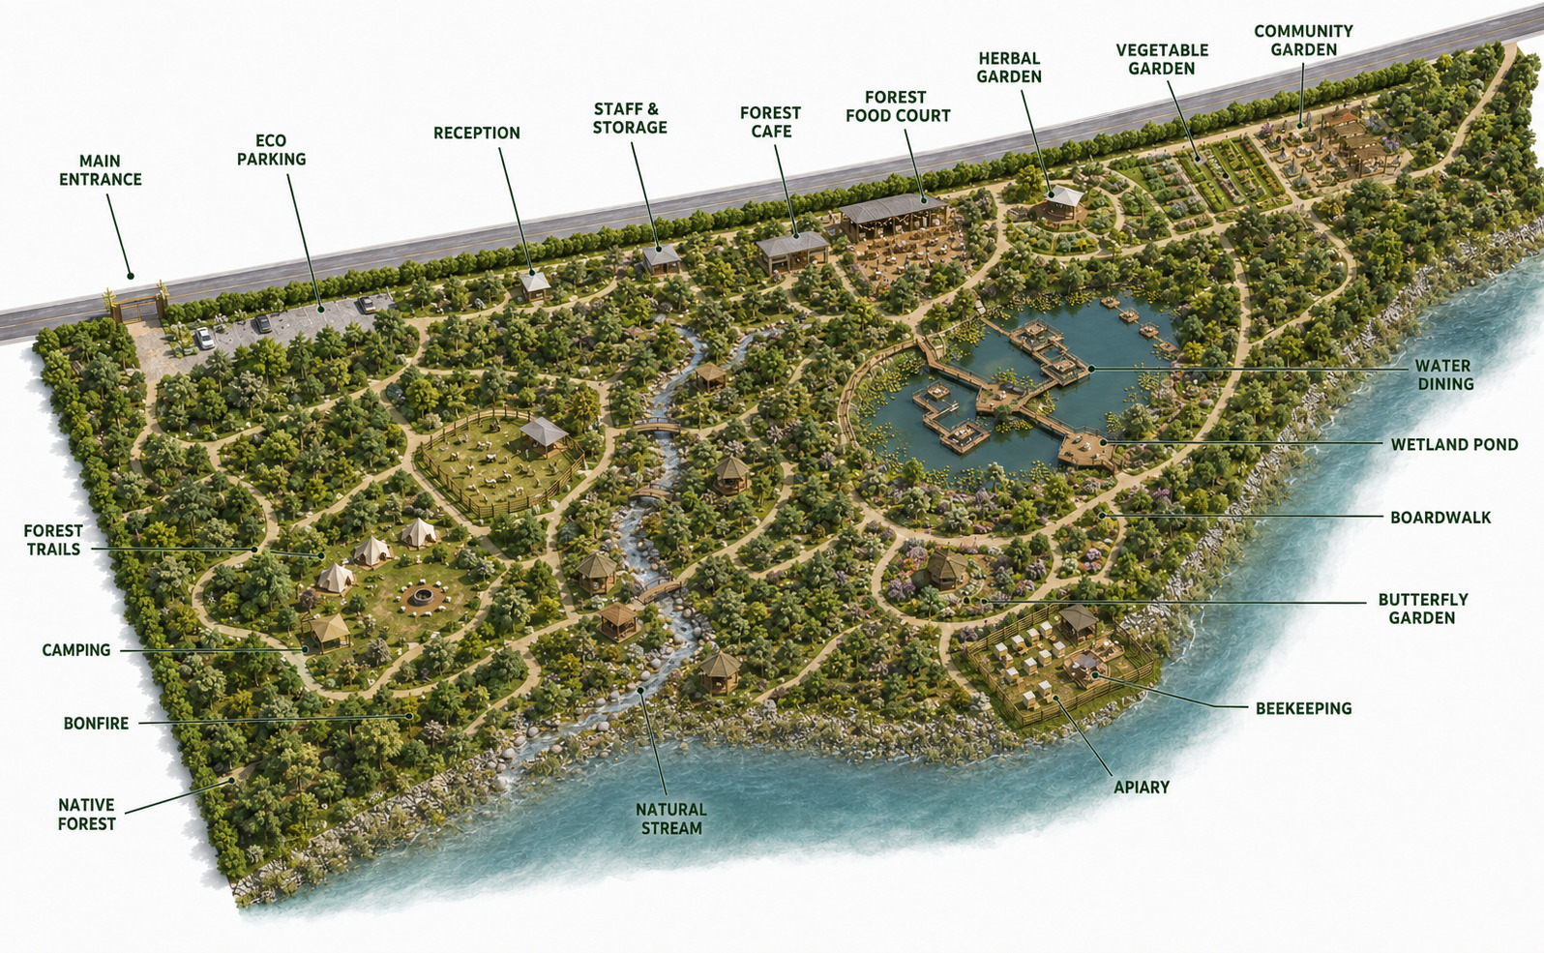
MASTER PLAN
One ecological trail network connects every activity
URBAN FOREST • EDUCATION CITY
03
Notes:
[Sources]
- User-provided Google Slides: Urban Forest Presentation (Architect)
- User-provided PDFs: Urban Forest Dimensions; Urban Forest Topography Survey
- User-provided activity reference images
- AI-generated conceptual visualization based on the supplied brief and references
[/Sources]

Slide 4
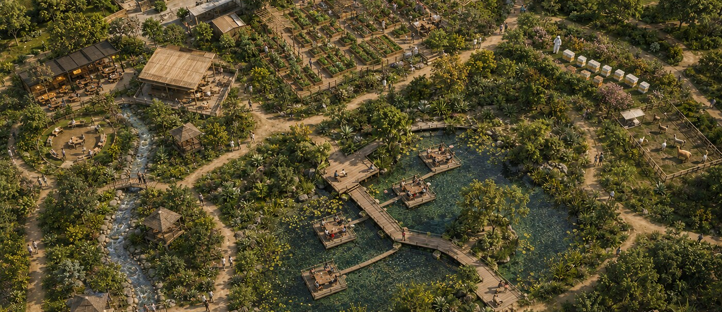
04
The activity hub keeps every use visible
Arrival, gardens, food, learning, water and recreation are grouped around clear paths while the native forest remains dominant.
URBAN FOREST • EDUCATION CITY
04
Notes:
[Sources]
- User-provided Google Slides: Urban Forest Presentation (Architect)
- User-provided PDFs: Urban Forest Dimensions; Urban Forest Topography Survey
- User-provided activity reference images
- AI-generated conceptual visualization based on the supplied brief and references
[/Sources]

Slide 5
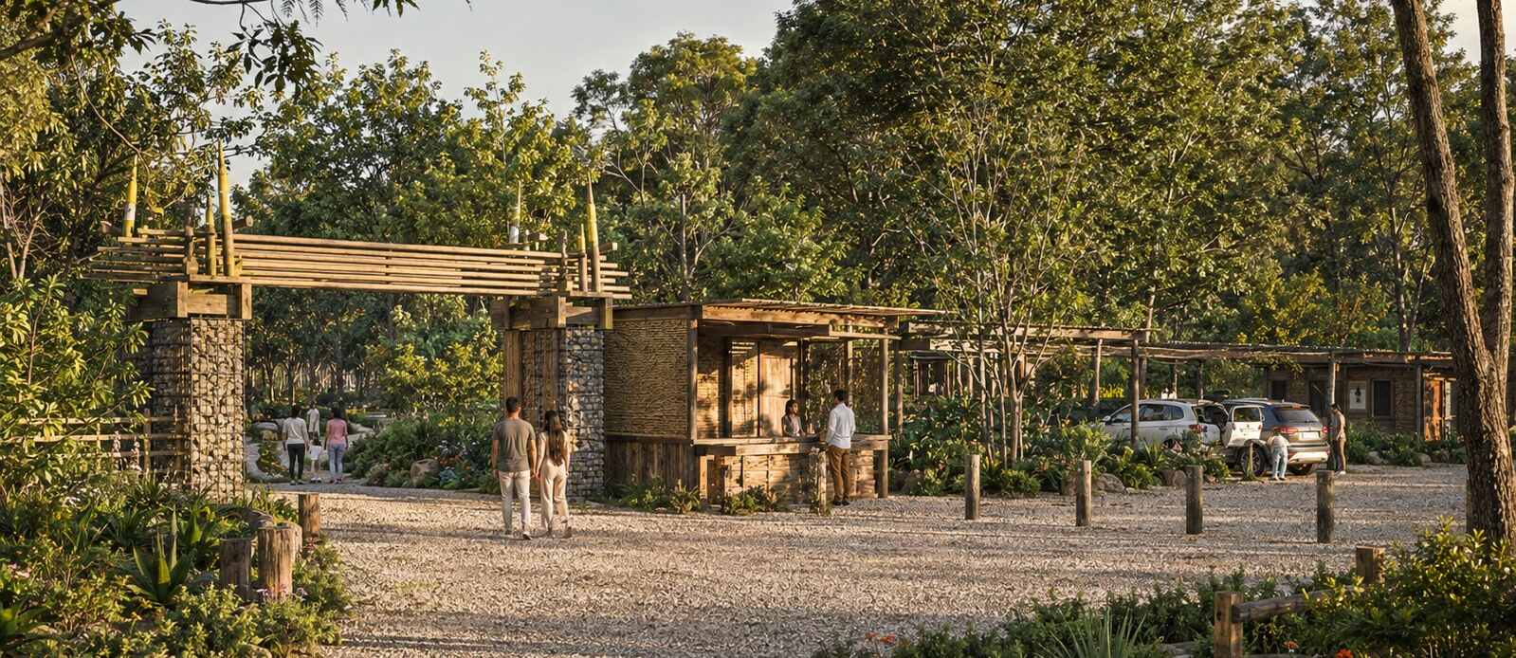
05
A modest, welcoming arrival
The entrance combines reception, limited permeable parking and discreet staff facilities before visitors enter the trail system.
URBAN FOREST • EDUCATION CITY
05
Notes:
[Sources]
- User-provided Google Slides: Urban Forest Presentation (Architect)
- User-provided PDFs: Urban Forest Dimensions; Urban Forest Topography Survey
- User-provided activity reference images
- AI-generated conceptual visualization based on the supplied brief and references
[/Sources]

Slide 6
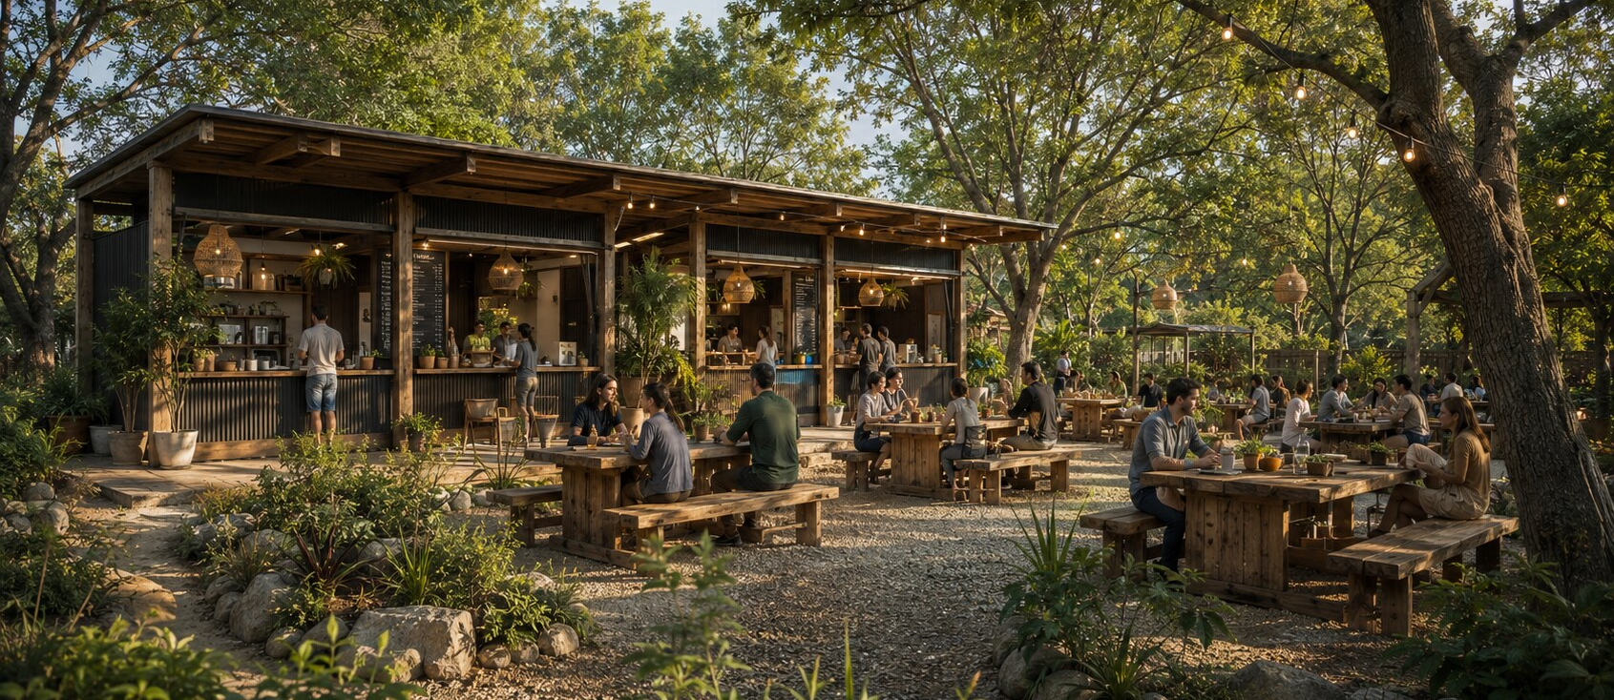
06
A shaded forest food court
Compact service kiosks, communal timber tables and gravel surfacing create a lively destination without a large building footprint.
URBAN FOREST • EDUCATION CITY
06
Notes:
[Sources]
- User-provided Google Slides: Urban Forest Presentation (Architect)
- User-provided PDFs: Urban Forest Dimensions; Urban Forest Topography Survey
- User-provided activity reference images
- AI-generated conceptual visualization based on the supplied brief and references
[/Sources]

Slide 7
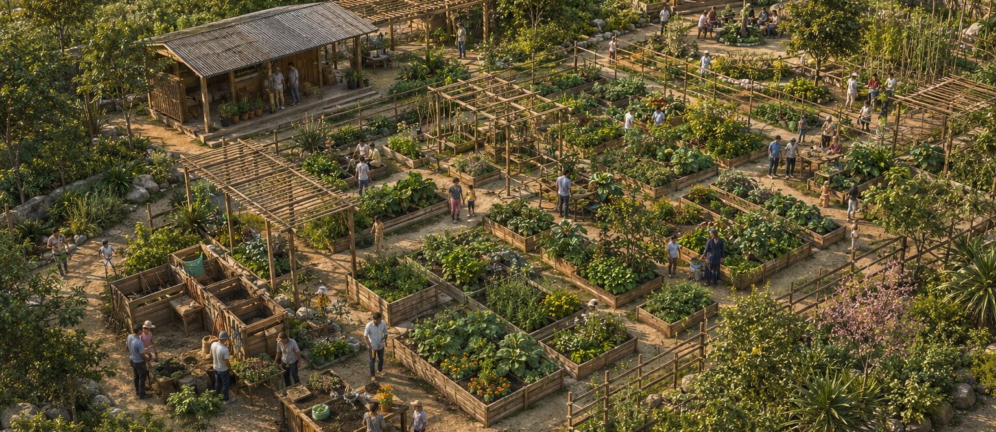
07
Gardens become places to learn and participate
Herbal, vegetable and community plots combine food production with workshops, composting, potting and environmental education.
URBAN FOREST • EDUCATION CITY
07
Notes:
[Sources]
- User-provided Google Slides: Urban Forest Presentation (Architect)
- User-provided PDFs: Urban Forest Dimensions; Urban Forest Topography Survey
- User-provided activity reference images
- AI-generated conceptual visualization based on the supplied brief and references
[/Sources]

Slide 8
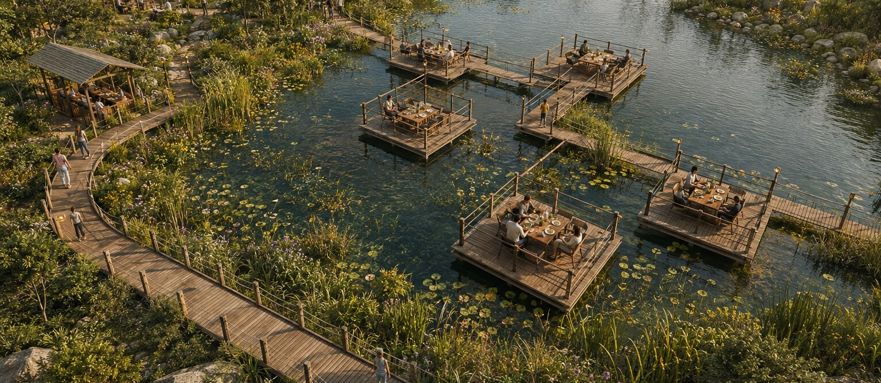
08
The wetland anchors the visitor experience
A natural pond, boardwalk and modest shallow-water dining platforms support ecology, observation and controlled hospitality.
URBAN FOREST • EDUCATION CITY
08
Notes:
[Sources]
- User-provided Google Slides: Urban Forest Presentation (Architect)
- User-provided PDFs: Urban Forest Dimensions; Urban Forest Topography Survey
- User-provided activity reference images
- AI-generated conceptual visualization based on the supplied brief and references
[/Sources]

Slide 9
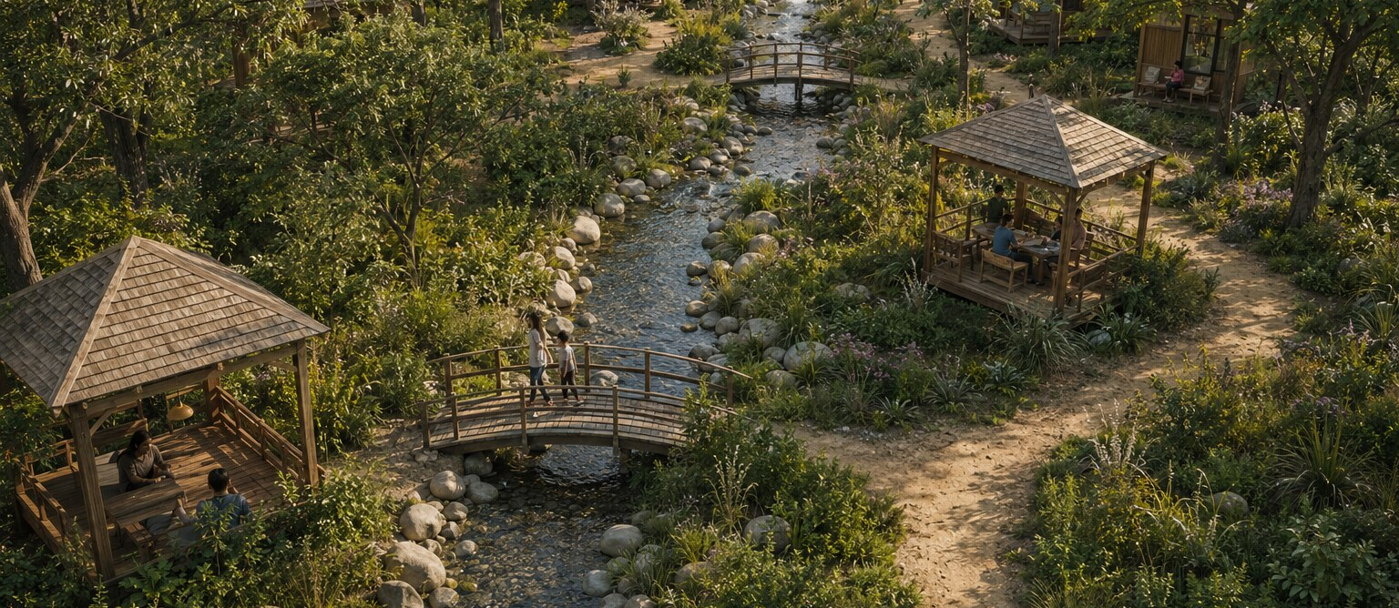
09
The stream extends water through the forest
Stone-lined channels, timber bridges, gazebos and small retreat cabins create a quieter experience between wetland and camping.
URBAN FOREST • EDUCATION CITY
09
Notes:
[Sources]
- User-provided Google Slides: Urban Forest Presentation (Architect)
- User-provided PDFs: Urban Forest Dimensions; Urban Forest Topography Survey
- User-provided activity reference images
- AI-generated conceptual visualization based on the supplied brief and references
[/Sources]

Slide 10
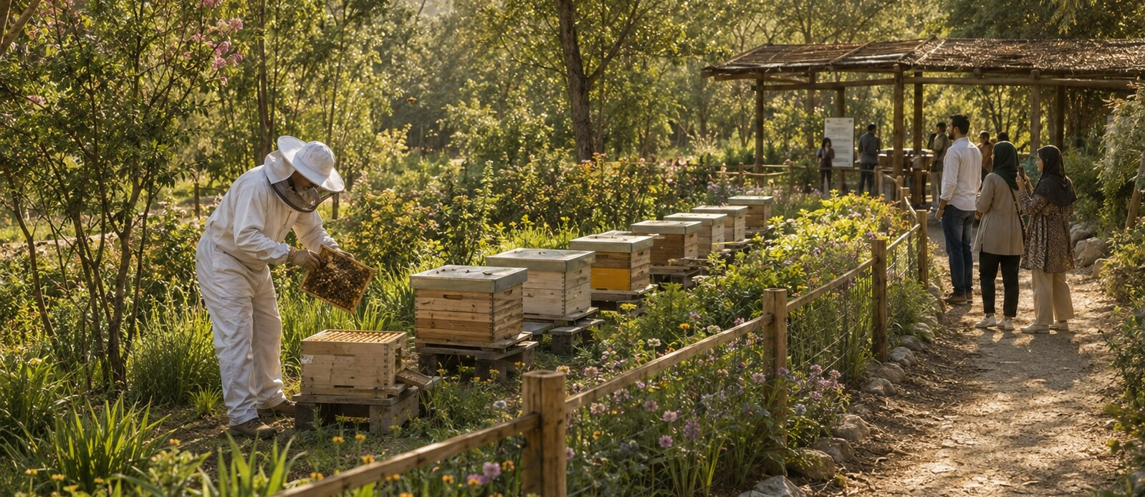
10
Beekeeping supports ecology and education
A screened apiary provides safe working space, pollinator planting and a separated visitor observation route.
URBAN FOREST • EDUCATION CITY
10
Notes:
[Sources]
- User-provided Google Slides: Urban Forest Presentation (Architect)
- User-provided PDFs: Urban Forest Dimensions; Urban Forest Topography Survey
- User-provided activity reference images
- AI-generated conceptual visualization based on the supplied brief and references
[/Sources]

Slide 11
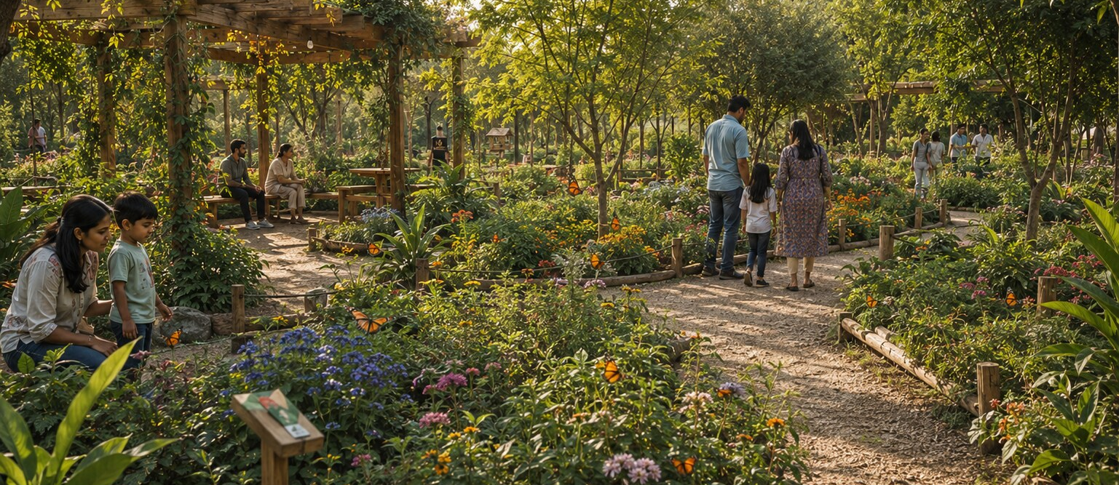
11
The butterfly garden makes biodiversity visible
Native nectar and host plants, shaded seating and accessible paths create a calm learning environment for families and students.
URBAN FOREST • EDUCATION CITY
11
Notes:
[Sources]
- User-provided Google Slides: Urban Forest Presentation (Architect)
- User-provided PDFs: Urban Forest Dimensions; Urban Forest Topography Survey
- User-provided activity reference images
- AI-generated conceptual visualization based on the supplied brief and references
[/Sources]

Slide 12
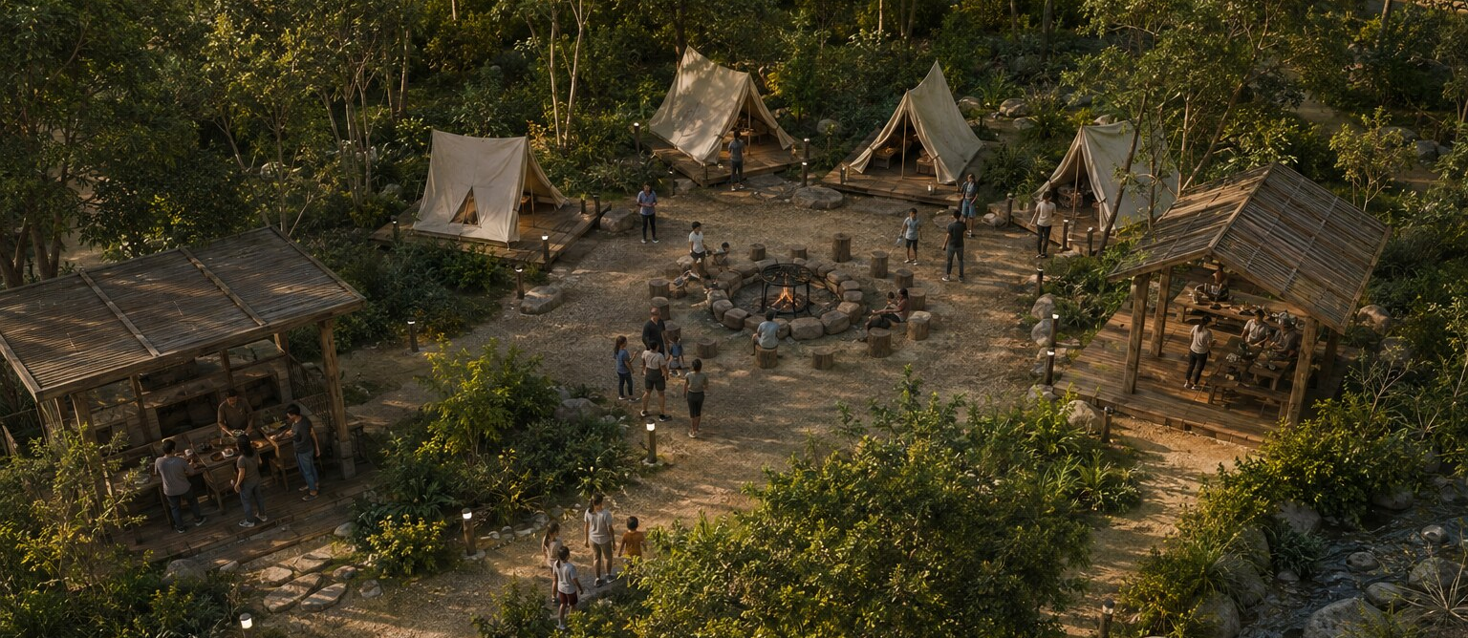
12
Camping is contained within a forest clearing
Simple tents, timber shelters and a controlled circular bonfire offer seasonal recreation with a strong planted buffer.
URBAN FOREST • EDUCATION CITY
12
Notes:
[Sources]
- User-provided Google Slides: Urban Forest Presentation (Architect)
- User-provided PDFs: Urban Forest Dimensions; Urban Forest Topography Survey
- User-provided activity reference images
- AI-generated conceptual visualization based on the supplied brief and references
[/Sources]

Slide 13
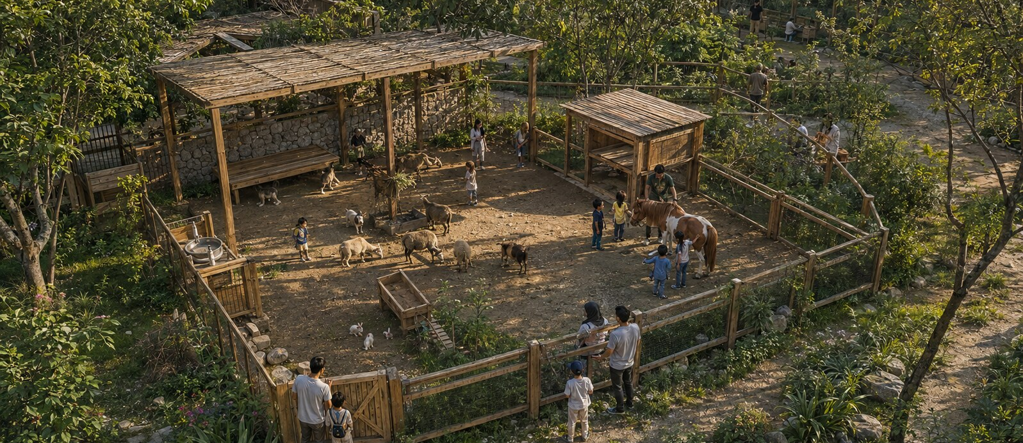
13
The petting zoo prioritizes care and supervision
Shaded shelters, a keeper gate, hand-washing and separated circulation support animal welfare and safe family interaction.
URBAN FOREST • EDUCATION CITY
13
Notes:
[Sources]
- User-provided Google Slides: Urban Forest Presentation (Architect)
- User-provided PDFs: Urban Forest Dimensions; Urban Forest Topography Survey
- User-provided activity reference images
- AI-generated conceptual visualization based on the supplied brief and references
[/Sources]

Slide 14
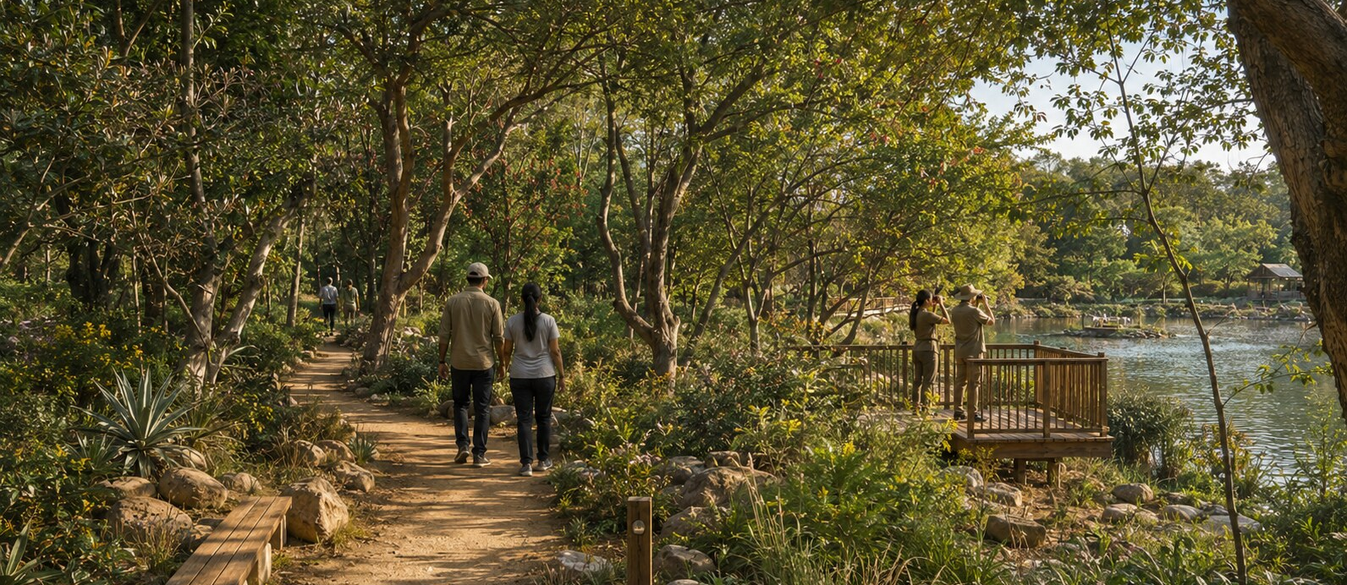
14
Forest trails provide the connective experience
Earth paths, benches and reservoir viewing points immerse visitors in layered native woodland while keeping movement legible.
URBAN FOREST • EDUCATION CITY
14
Notes:
[Sources]
- User-provided Google Slides: Urban Forest Presentation (Architect)
- User-provided PDFs: Urban Forest Dimensions; Urban Forest Topography Survey
- User-provided activity reference images
- AI-generated conceptual visualization based on the supplied brief and references
[/Sources]

Slide 15
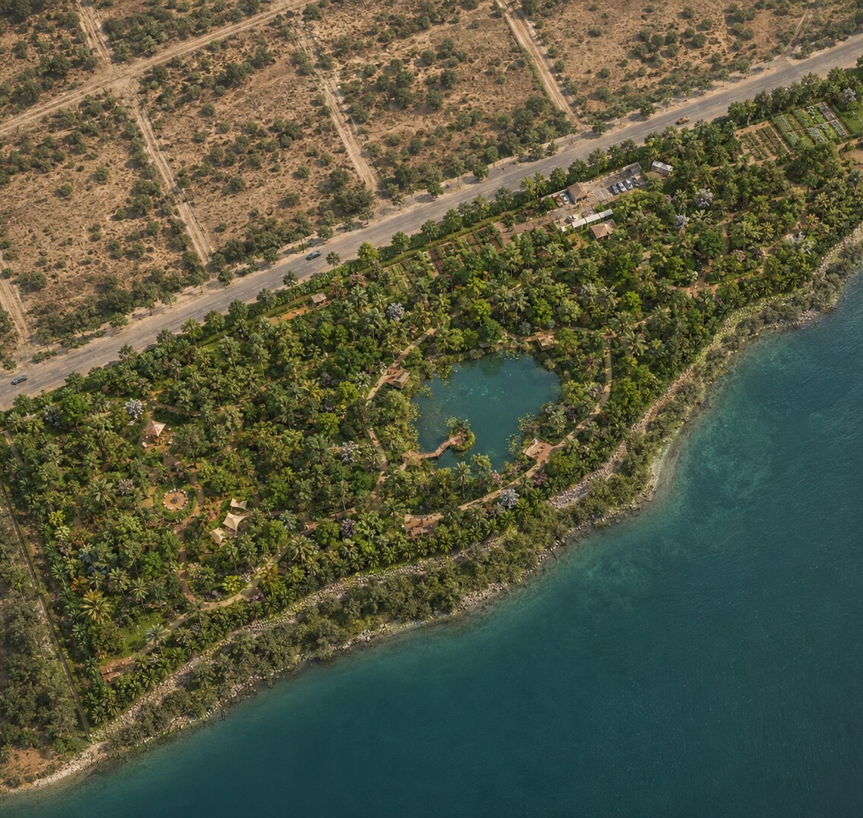
PROJECT OUTCOME
A forest first.
Activities second.
The master plan concentrates visitor facilities into clear nodes, protects the water edge and reserves the majority of the land for native ecological restoration.
20 acres • connected trails • low-impact architecture
URBAN FOREST • EDUCATION CITY
15
Notes:
[Sources]
- User-provided Google Slides: Urban Forest Presentation (Architect)
- User-provided PDFs: Urban Forest Dimensions; Urban Forest Topography Survey
- User-provided activity reference images
- AI-generated conceptual visualization based on the supplied brief and references
[/Sources]

